Slide 1
Named Entity Recognition and Neural Sequence Tagging Model
CS 162: Natural Language Processing
Nanyun (Violet) Peng
Course website: https://vnpeng.net/cs162_win24.html
syllabus,
announcements,
slides,
homeworks
1

Slide 2
Important Announcements
Homework 3 is due Next Monday
Course Project final report is due 2 weeks from now on March 18th, 11:59pm.

Slide 3
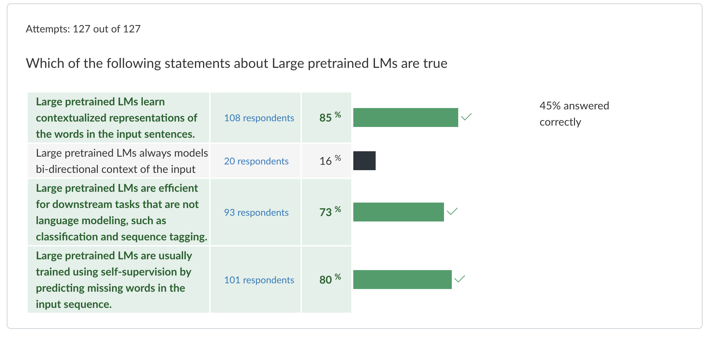
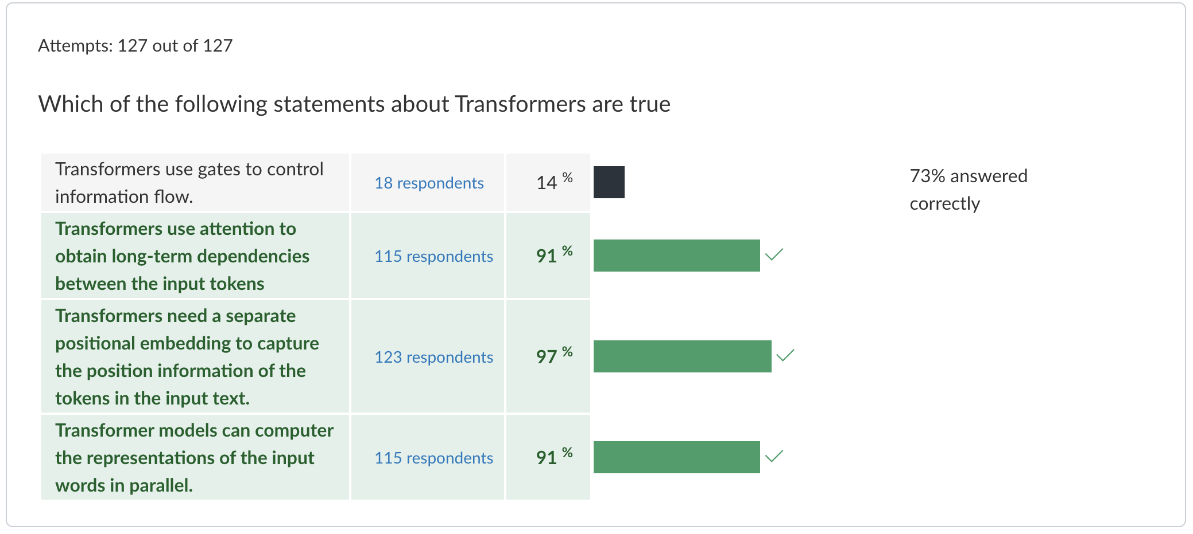
Quiz 5

Slide 4
Outline
Introduction to Information Extraction Tasks
Named Entity Recognition
Relation Extraction
Named Entity Recognition and Sequence Tagging
Neural MEMM models
RNNs-MEMM
Transformer-MEMM

Slide 5

A PubMed Article
T790M is present as a minor clone in NSCLC ,
and may be selected for during therapy .
This mutation has been shown to prevent the activation
of BIM in response to gefitinib
but can be overcome by an irreversible inhibitor of EGFR.
Notes:
Motivation example: a paragraph I took from PubMed, which is an online repository for medical publications, and we want to extract information from it.
If you take 3 sec. to skim through: audience should agree that this passage is somewhat obscure
And let’s see what information you can extract
Lead to the goal of information extraction: extract structured knowledge from unstructured texts.

Slide 6
A PubMed Article
present
T790M is present as a minor clone in NSCLC ,
and may be selected for during therapy .
This mutation has been shown to prevent the activation
of BIM in response to gefitinib
but can be overcome by an irreversible inhibitor of EGFR.
respond
Notes:
First, you will notice some technical terms (entities) from the texts.
They are termed as entities, which associate with some concrete concepts that are important in forming knowledge. The entities in different domain may care about different entities, such as… Later on in the talk, I will give more details on how we do entity extraction, which involves detecting entity boundaries and predicting entity types. Here I use different color to denote different entity types. Introduce each entity…
There are also relations between the entities. (binary relations, nary relations). I will also explain how to do entity extraction later in this talk.
You can see that entities and relation extractions are two essential elements that constitute knowledge.

Slide 7
U.S. intelligence officials now believe North Korea
is developing the technology to make nuclear
warheads small enough to fit atop the country 's
growing arsenal of missiles potentially putting
Tokyo and U.S. troops based in Japan at risk ,
according to officials who have received the intelligence reports .

Slide 8
U.S. intelligence officials now believe North Korea
is developing the technology to make nuclear
warheads small enough to fit atop the country 's
growing arsenal of missiles potentially putting
Tokyo and U.S. troops based in Japan at risk ,
according to officials who have received the intelligence reports .

Slide 9
U.S. intelligence officials now believe North Korea
is developing the technology to make nuclear
warheads small enough to fit atop the country 's
growing arsenal of missiles potentially putting
Tokyo and U.S. troops based in Japan at risk ,
according to officials who have received the intelligence reports .
PART-WHOLE
ORG-AFF
ART
ART
ORG-AFF
PHYS

Slide 10
Social Media
“Yess! Yess! Its ofﬁcial Nintendo announced today that they Will release the Nintendo 3DS in north America march 27 for $250”
COMPANY | PRODUCT | DATE | PRICE | REGION
PRODUCT RELEASE
Notes:
Next we might classify this post as a PRODUCT RELEASE event.
We might also have a pre-defined idea that product release events involve a company, a product, a date on which the product is released, the price and the geographical region where it is being released.

Slide 11
Social Media
“Yess! Yess! Its ofﬁcial Nintendo announced today that they Will release the Nintendo 3DS in north America march 27 for $250”
COMPANY | PRODUCT | DATE | PRICE | REGION
Nintendo | 3DS | March 27 | $250 | North America
PRODUCT RELEASE
Notes:
And so the information extraction task is to fill in the fields for the event.
So you could imagine many events mentioned on Twitter which fit this general schema.
If we can automatically convert tweets into database rows like this, then we can do SQL-like queries and higher-level data mining and analysis on top of this that wasn’t possible by just directly looking at the text.

Slide 12








IE
IE
Structured Knowledge
Entity | Entity | Entity | Relation
T790M | EGFR | gefitinib | Resist
Obama | U.S. |  | President_of
… | … |  | …
IE
IE
IE
Notes:
The goal of IE is to extract structured knowledge from unstructured text.
There are many domains that the structured knowledge can be extracted from.

Slide 13
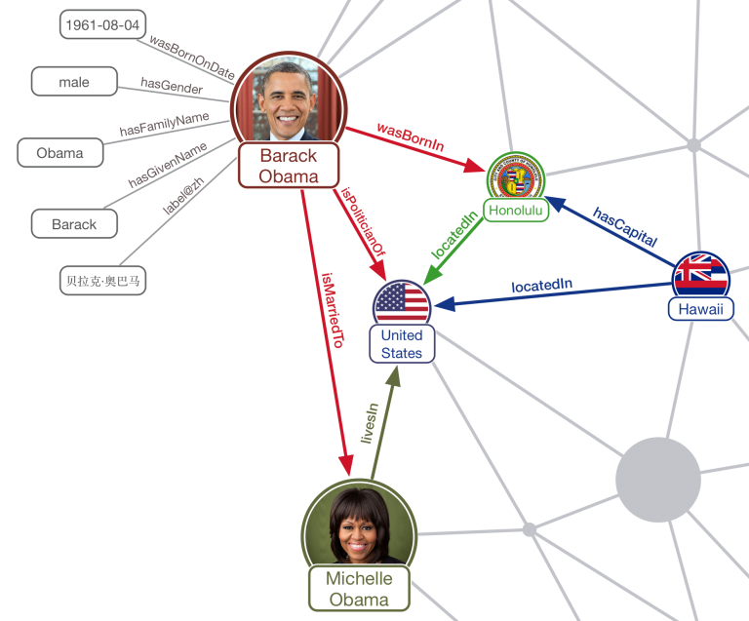
Knowledge Grpah

Slide 14

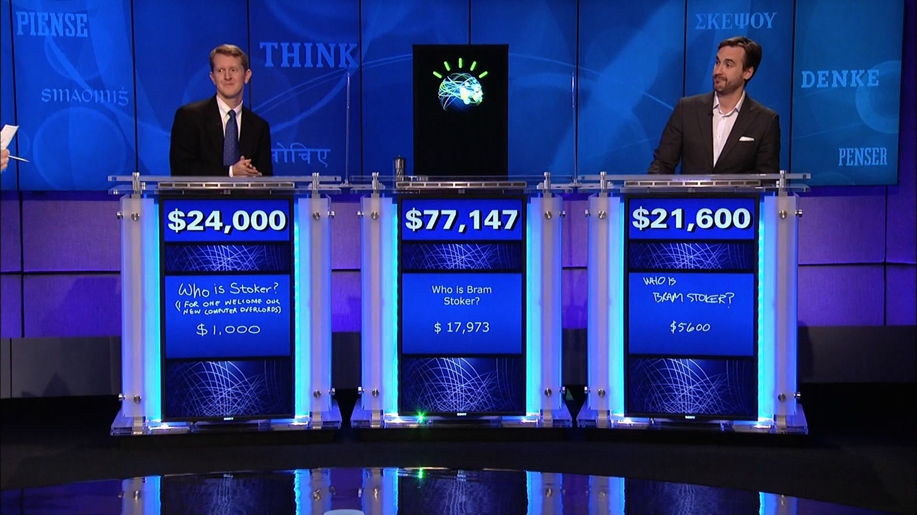

Structured Knowledge
Entity | Entity | Entity | Relation
T790M | EGFR | gefitinib | Resist
Obama | U.S. |  | President_of
Philadelphia | PA. |  | Locate_in
… | … |  | …
Notes:
Structured knowledge is what enables AI systems to detect important event that can help predict the stock price, or even to be able to answer Jeopardy questions at a superhuman level or find new combinations of drugs to fight cancer

Slide 15
Named Entities
Named entity, in its core usage, means anything that can be referred to with a proper name. Most common 4 tags:
PER (Person): “Marie Curie”
LOC (Location): “New York City”
ORG (Organization): “Stanford University”
GPE (Geo-Political Entity): "Boulder, Colorado"
Often multi-word phrases
But the term is also extended to things that aren't entities:
dates, times, prices
Notes:
Proper names are another important and anciently studied linguistic category. While parts of speech are generally assigned to individual words or morphemes, a proper name is often an entire multiword phrase, like the name “Marie Curie”, the location “New York City”, or the organization “Stanford University”.
Part of speech tagging can tell us that words like Janet, Stanford University, and Colorado are all proper nouns; being a proper noun is a grammatical property of these words. But viewed from a semantic perspective, these proper nouns refer to different kinds of entities: Janet is a person, Stanford University is an organization,.. and Colorado is a location. A named entity is, roughly speaking, anything that can be referred to with a proper name: a person, a location, an organization.
Four entity tags are most common: PER (person), LOC (location), ORG (organization), or GPE (geo-political entity). However, the term named entity is commonly extended to include things that aren’t entities per se, including dates, times, and other kinds of temporal expressions, and even numerical expressions like prices.

Slide 16
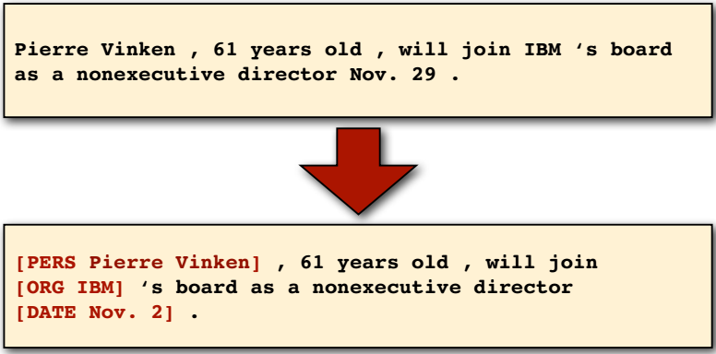
Named Entity Recognition
Task: identify all mentions of named entities (people, organizations, locations, dates) and tag their types from natural language texts.

Slide 17
NERs are very common in texts
Notes:
Here's a text showing some sample Named Entity Recognition output. You'll see 13 mentions of named entities including 5 organizations, 4 locations, 2 times, 1 person, and 1 mention of money.

Slide 18
Example Applications
Question Answering
Which companies are releasing new smartphones new products in Europe this Spring?
Alert me anytime a new smartphone is announced in the U.S.
Sentiment Analysis
How do people think about iphone 13 pro?
Data Analysis
Analyze trends in product releases across different industries
Is there a correlation between price and date of release?

Slide 19
Why is NER hard
Type ambiguity
Notes:
Unlike part-of-speech tagging, where there is no segmentation problem since each word gets one tag, the task of named entity recognition is to find and label
spans of text, and is difficult partly because of the ambiguity of segmentation; we need to decide what’s an entity and what isn’t, and where the boundaries are.
Indeed, most words in a text will not be named entities.
Another difficulty is caused by type ambiguity the name Washington can refer to the educator Booker T Washington, the sports team, the location, or the geo-political entity.

Slide 20
Supervised Learning Setting
Assume we have annotated examples
Tag set:
GPE, ORG, PER, O…
NER Tagger
Words
Tags
U.S./GPE intelligence/ORG officials/PER now/O believe/O North/GPE Korea/GPE is/O developing/O the/O technology/O to/O make/O nuclear/O warheads/O small/O.
U.S.
intelligen.
officials
now
believe
North
Korea
GPE
ORG
PER
O
……

Slide 21
BIO Tagging
[PER Jane Villanueva] of [ORG United] , a unit of [ORG United Airlines Holding] , said the fare applies to the [LOC Chicago ] route.
Beginning of entities
Inside of entities
Outside of entities
Notes:
Here's shows the same sentence represented with BIO tagging. Notice we have tags orrresponding to people, organizations, and locations. And now we have one tag per token.

Slide 22
Standard algorithms for NER
The Sequence Tagging Problem that we’re familiar with!
Hidden Markov Models
Maximum Entropy Markov Models (MEMM) / Conditional Random Fields (CRF)
Neural sequence models (RNNs or Transformers)
Neural CRF models
Large Language Models (like BERT), finetuned
Notes:
Like part of speech tagging, named entity recognition is done by supervised machine learning, where we have a human-labeled training set in which some text is marked up with named entity tags. We can use classic ML algorithms like HMMs or CRFs, or neural models.

Slide 23
RNNs/Transformers For Sequence Tagging
B-ORG
B-PER
B-LOC

Slide 24
Limitations of RNNs/Transformers for Sequential Tagging
Completely ignored the interdependencies of the outputs
Will this work? Yes.
Liang et. al. (2008), Structure Compilation: Trading Structure for Features
Is this the best model? Not necessarily.

Slide 25
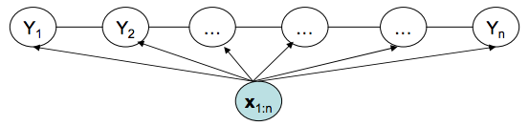
Recall MEMMs for Sequential Tagging
Arbitrary features on the input side
Markov assumption on the output side

Slide 26
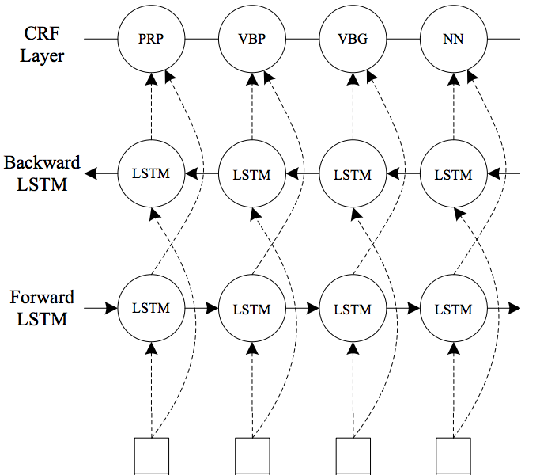
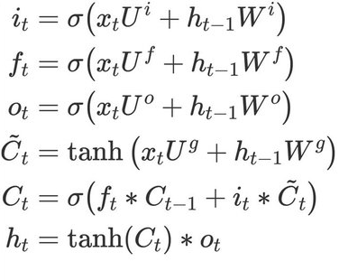
Combining MEMMs with RNNs
MEMM
B-ORG
O
B-PER
O
Recall LSTMs:
U.N
official
Ekeus
heads
……

Slide 27
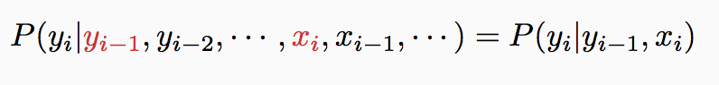
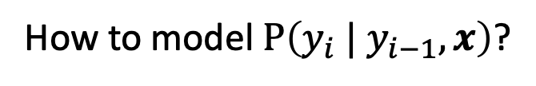
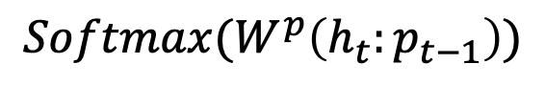
Combining MEMMs with RNNs
Recall MEMM:
MEMM
B-ORG
O
B-PER
O
y_{t-1}
y_{t}
Conditional
model
x_{t}
How to model $P\left(y_{i} | y_{i−1}, x\right)$?
$$Softmax(W^{p}\left(h_{t}:p_{t−1}\right))$$
U.N
official
Ekeus
heads
……
Notes:
How to combine both?
h_t is hidden layer of the input; p_{t-1} is the tag embedding

Slide 28
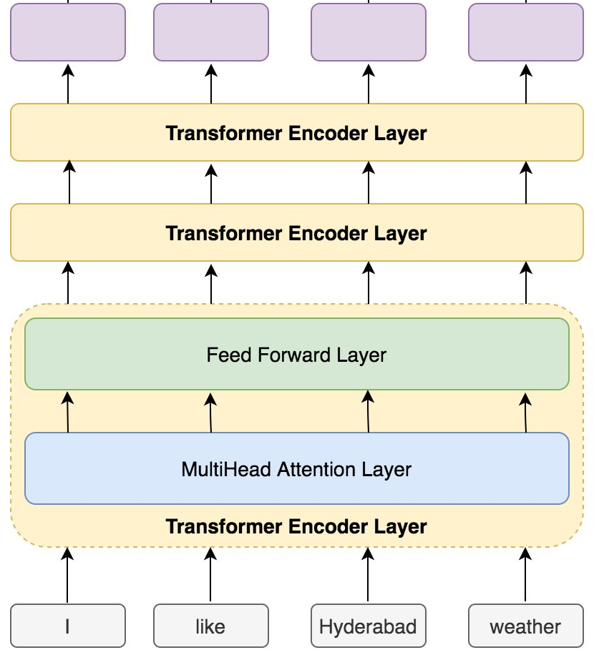
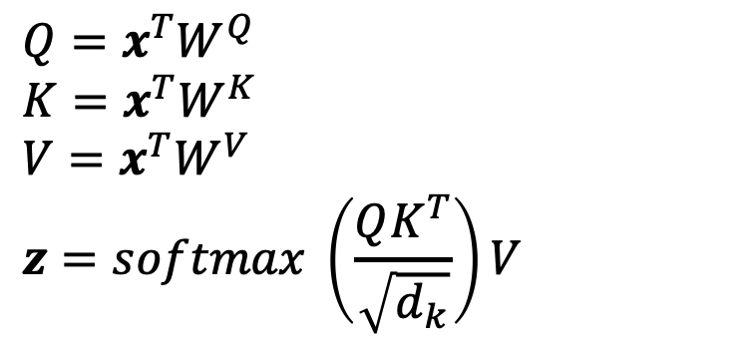
Combining MEMMs with Transformers
MEMM
B-ORG
O
B-PER
O
Recall Transformers:
$${Q=x}^{T}W^{Q}$$
$${K=x}^{T}W^{K}$$
$${V=x}^{T}W^{V}$$
$$z=softmax \left(\frac{QK^{T}}{\sqrt{d_{k}}}\right)V$$
Aside: more running examples for transformers with concrete numbers:
https://tinyurl.com/27rv6jwf
https://tinyurl.com/fndzzxj4
U.N
official
Ekeus
heads

Slide 29
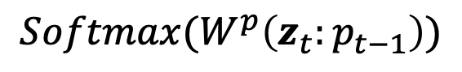
Combining MEMMs with Transformers
Recall MEMM:
MEMM
B-ORG
O
B-PER
O
y_{t-1}
y_{t}
Conditional
model
x_{t}
How to model $P\left(y_{i} | y_{i−1}, x\right)$?
$$Softmax(W^{p}\left(z_{t}:p_{t−1}\right))$$
U.N
official
Ekeus
heads

Slide 30
Combining Two Benefits
Directly model output dependencies by MEMMs.
Powerful automatic feature learning using RNNs/LSTMs.
Jointly training all the parameters to “share the modeling responsibilities”

Slide 31
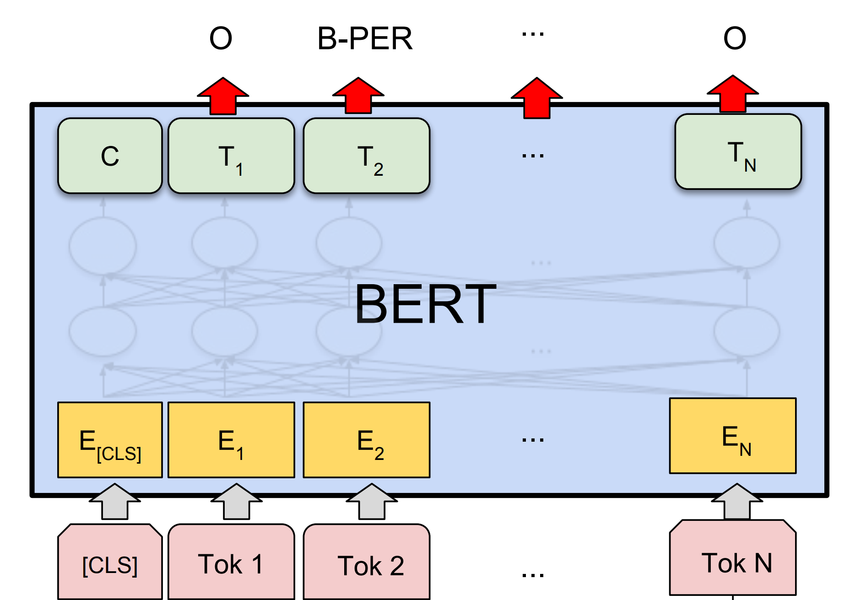
Bonus Point: Pretrained Language Models for NER

Slide 32
Next
Syntactic Parsing
CKY algorithm

